Slide 1
KANNAH CREEK BREWING CO.
How we got where we are and why we are still scared to death !

Slide 2
Find a Location
Original building site became scary
Next site (present) had been abandoned
Proximity to college had legal issues
Zoning was restrictive
Competitors were close by (not so bad)

Slide 3
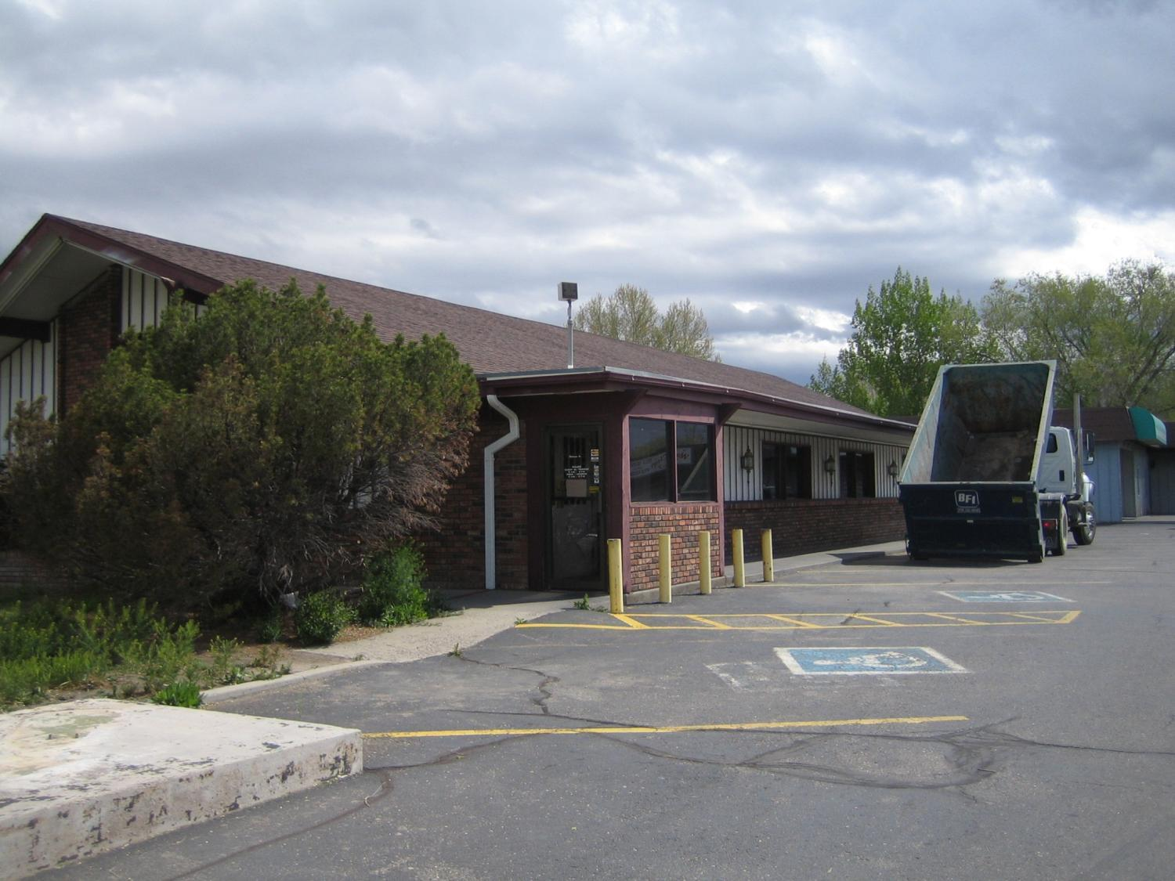

Slide 4
Fit a Budget
Original capital was $100k
Loan was $287k
Lease was the brite spot

Slide 5
Plan the Attack
Mitigate Location Legal Issues – Mesa State
Get a license – retail
Get a license – liquor
Get a license – food
Get a license – brewing
One more license - BATF

Slide 6
We Need Equipment?
Define the Market
Build a menu
See if the equipment will fit
You need stuff to make beer?

Slide 7
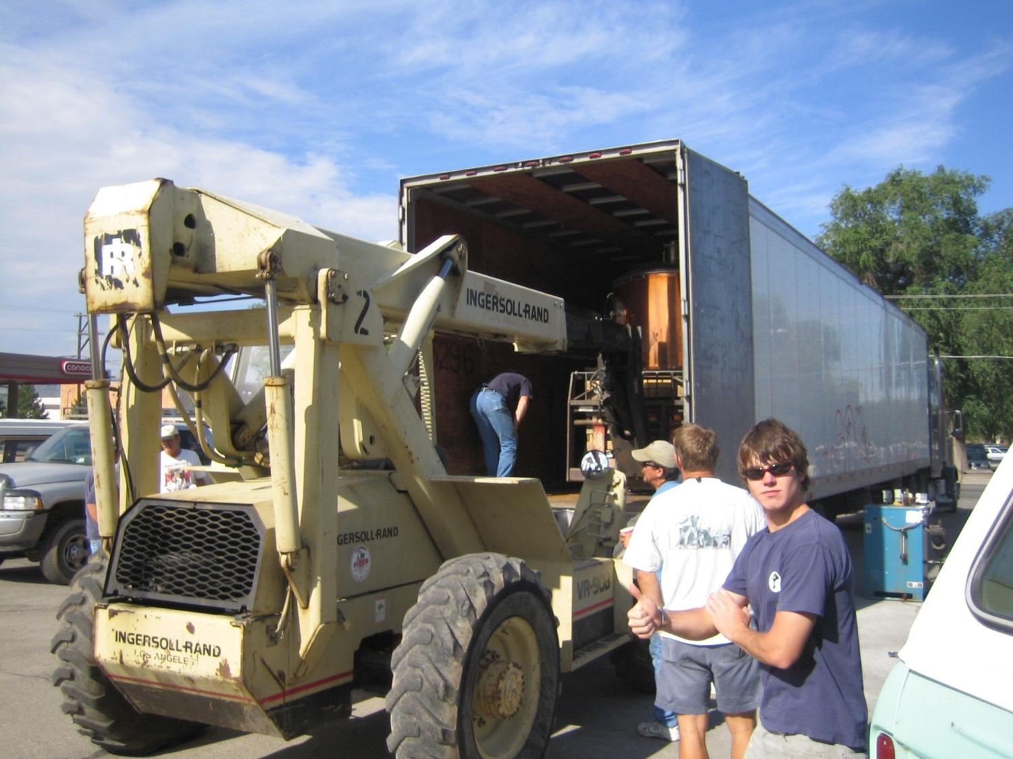

Slide 8
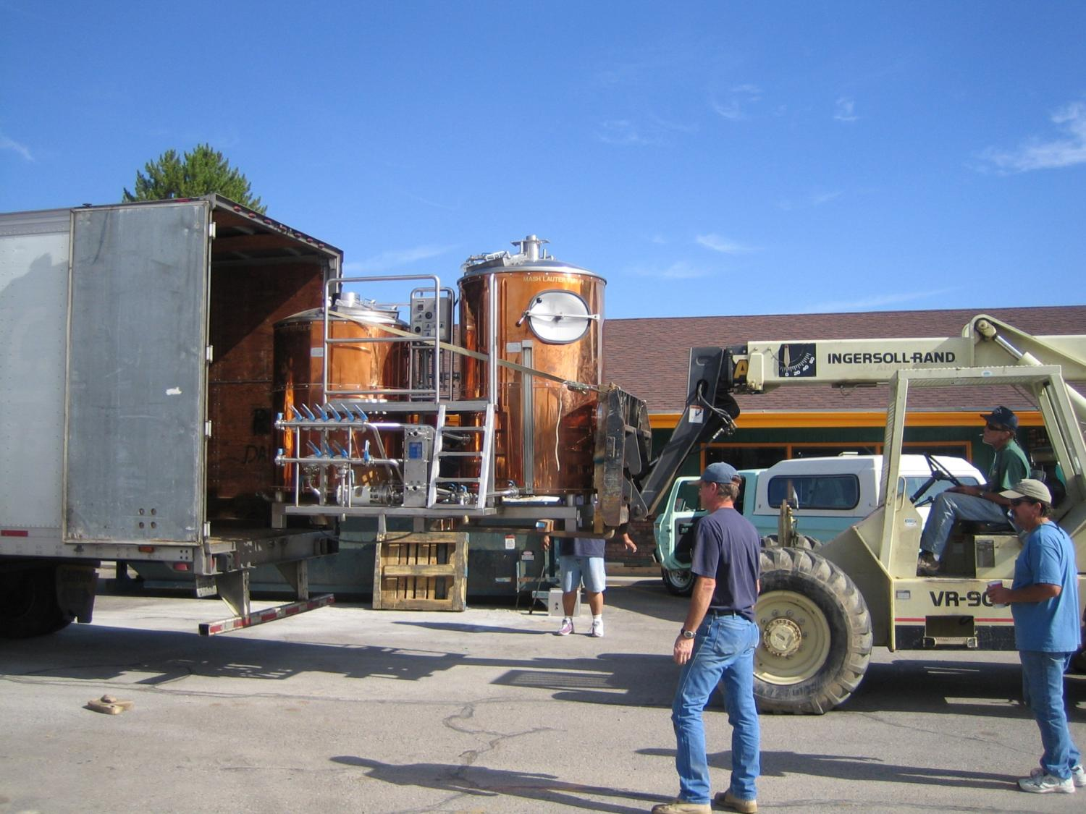

Slide 9
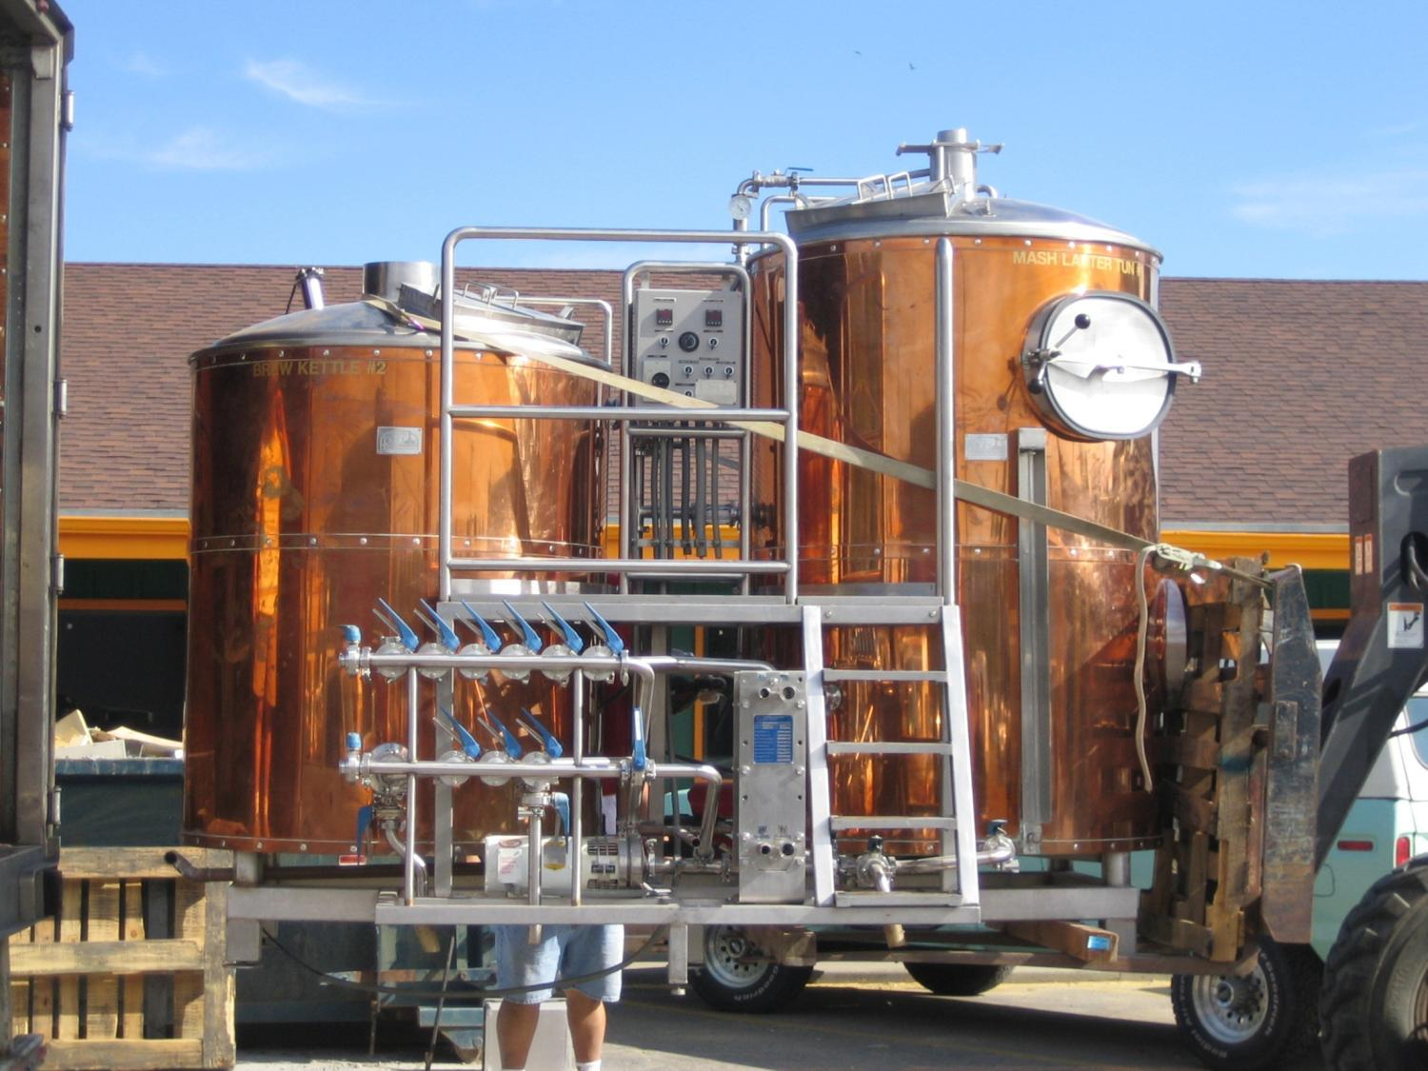

Slide 10
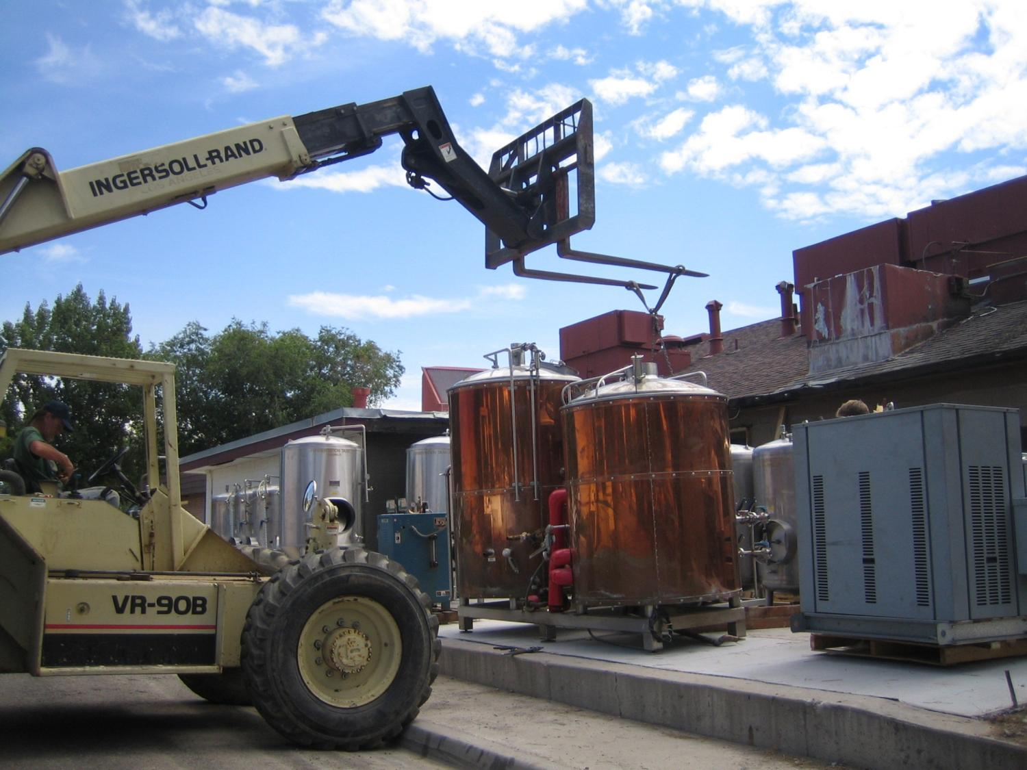

Slide 11
Build It
Dump the trash
Find a contractor
Stay on Budget
Check the bills – stay on budget
Build It but stop building it – open the doors

Slide 12
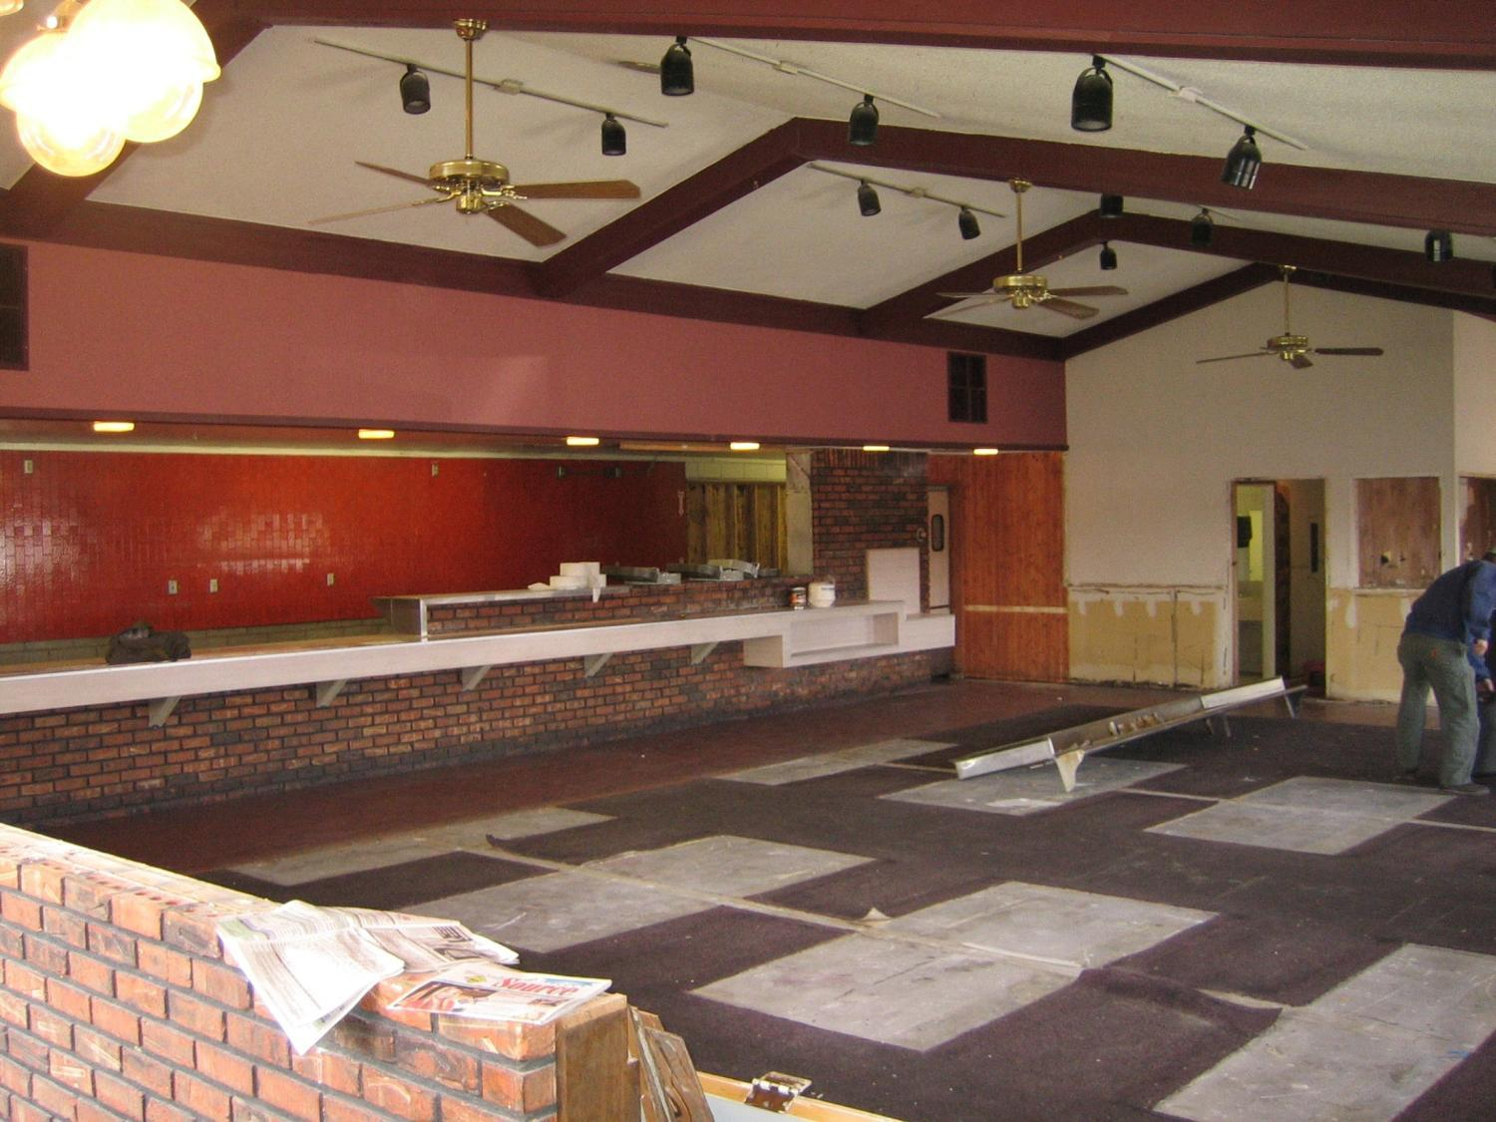

Slide 13
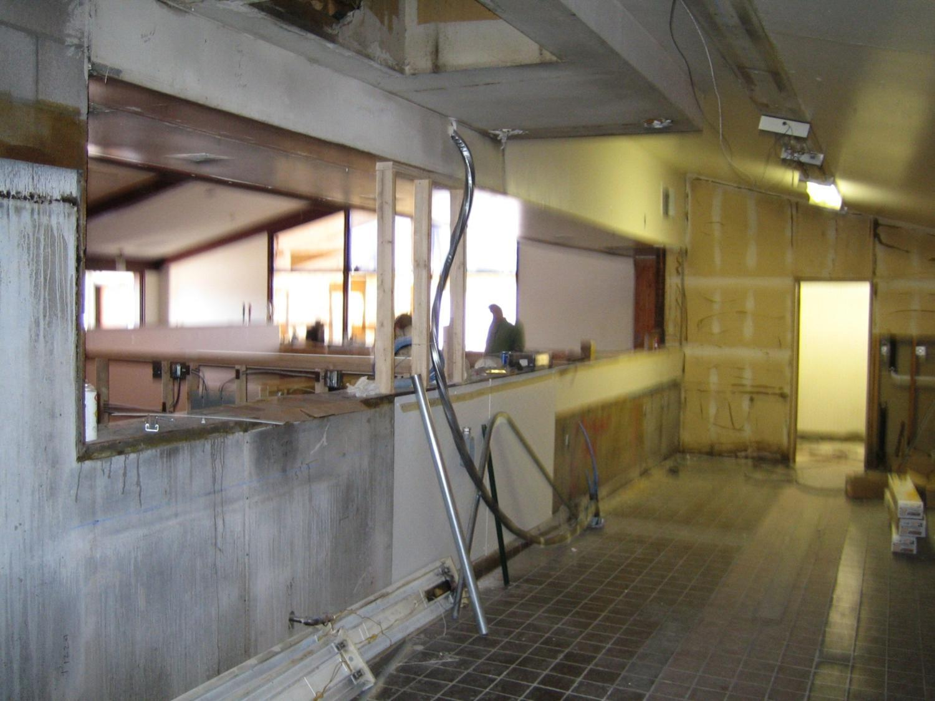

Slide 14
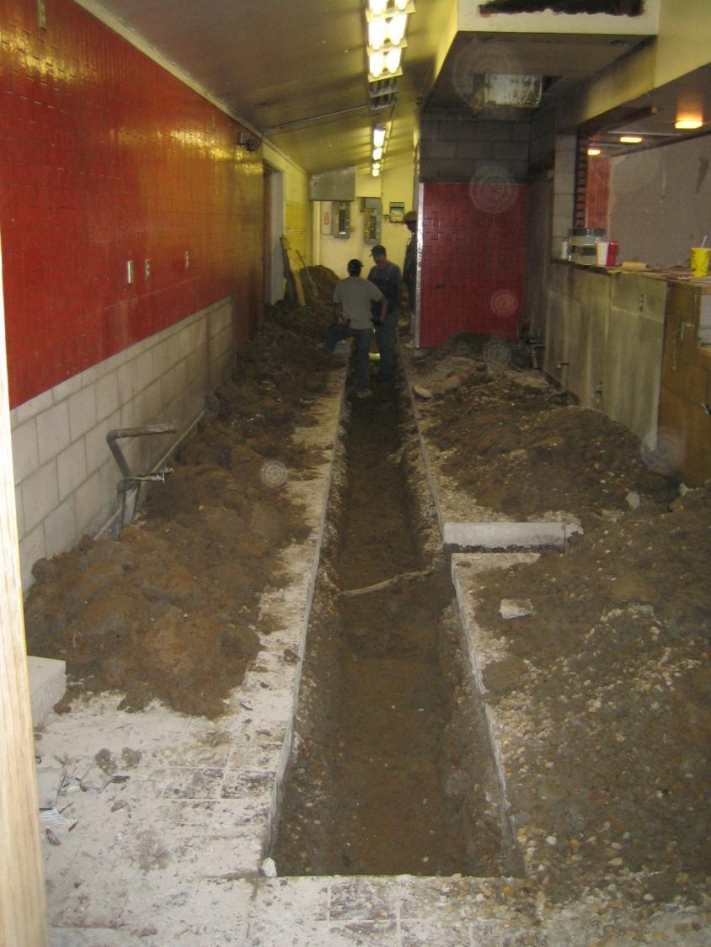

Slide 15
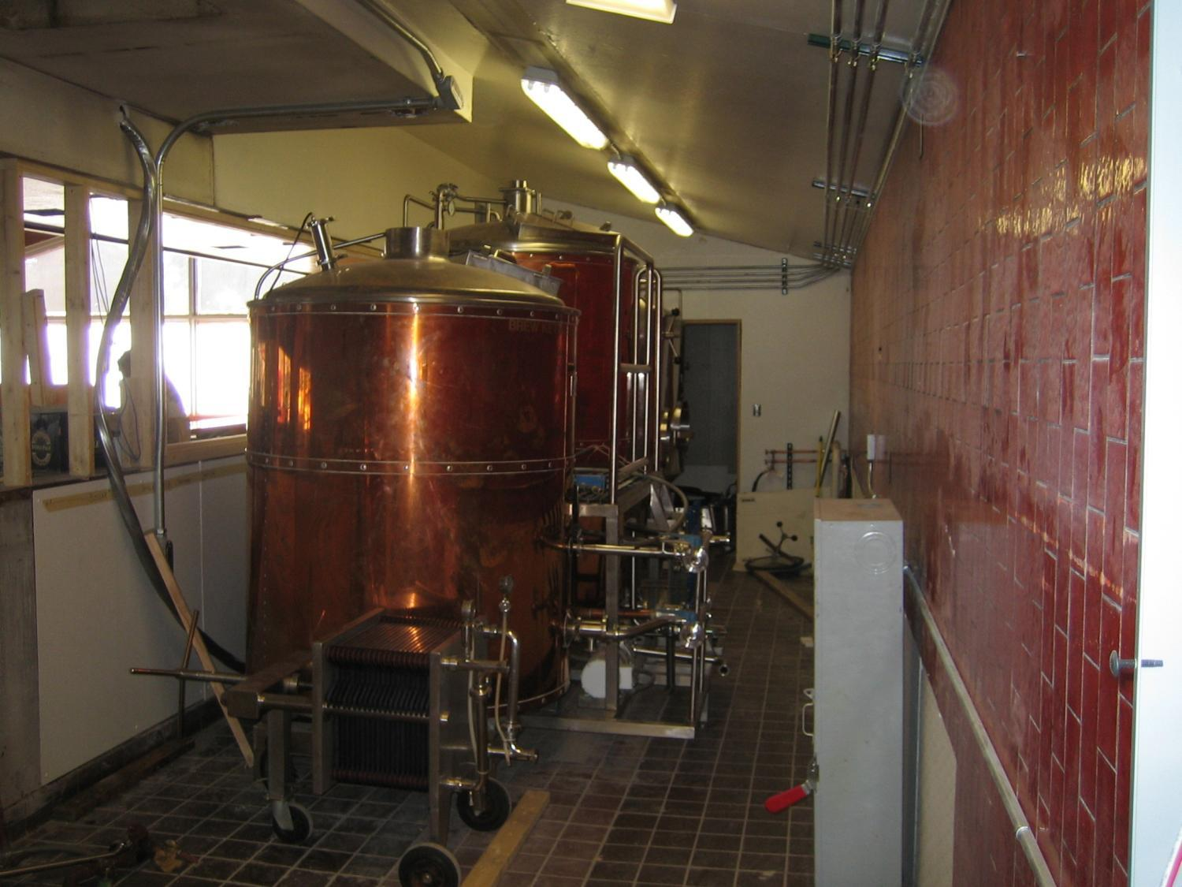

Slide 16
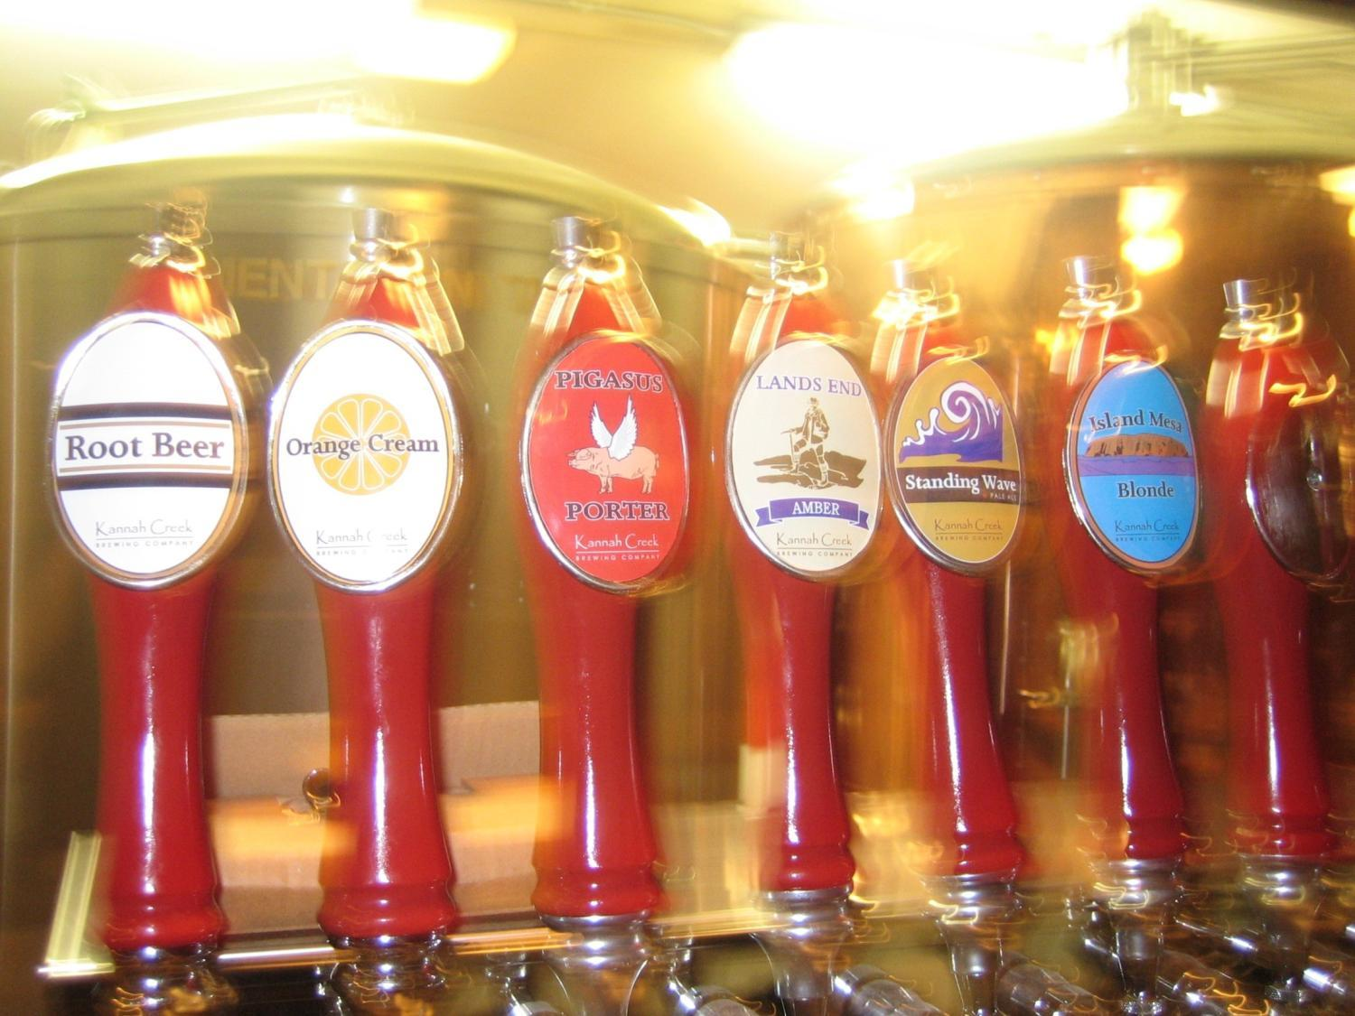

Slide 17
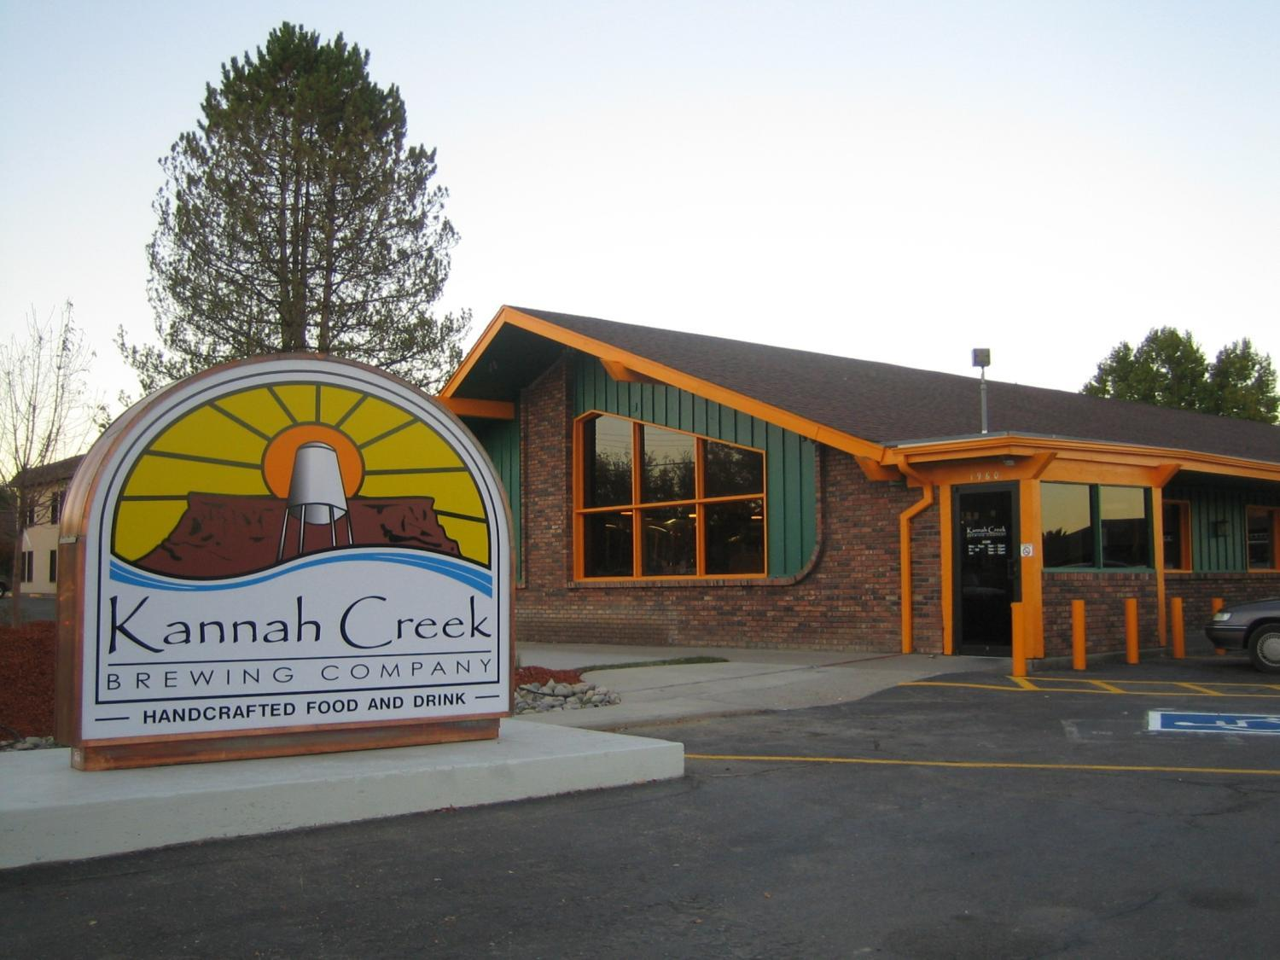

Slide 18
Where’s the Money?
Sell stuff for more than it costs to make
Sell good stuff and be consistent
Smile
Check the budget
Don’t Panic
Review the plan and always look to improve
Don’t go on vacation, no new cars

Slide 19
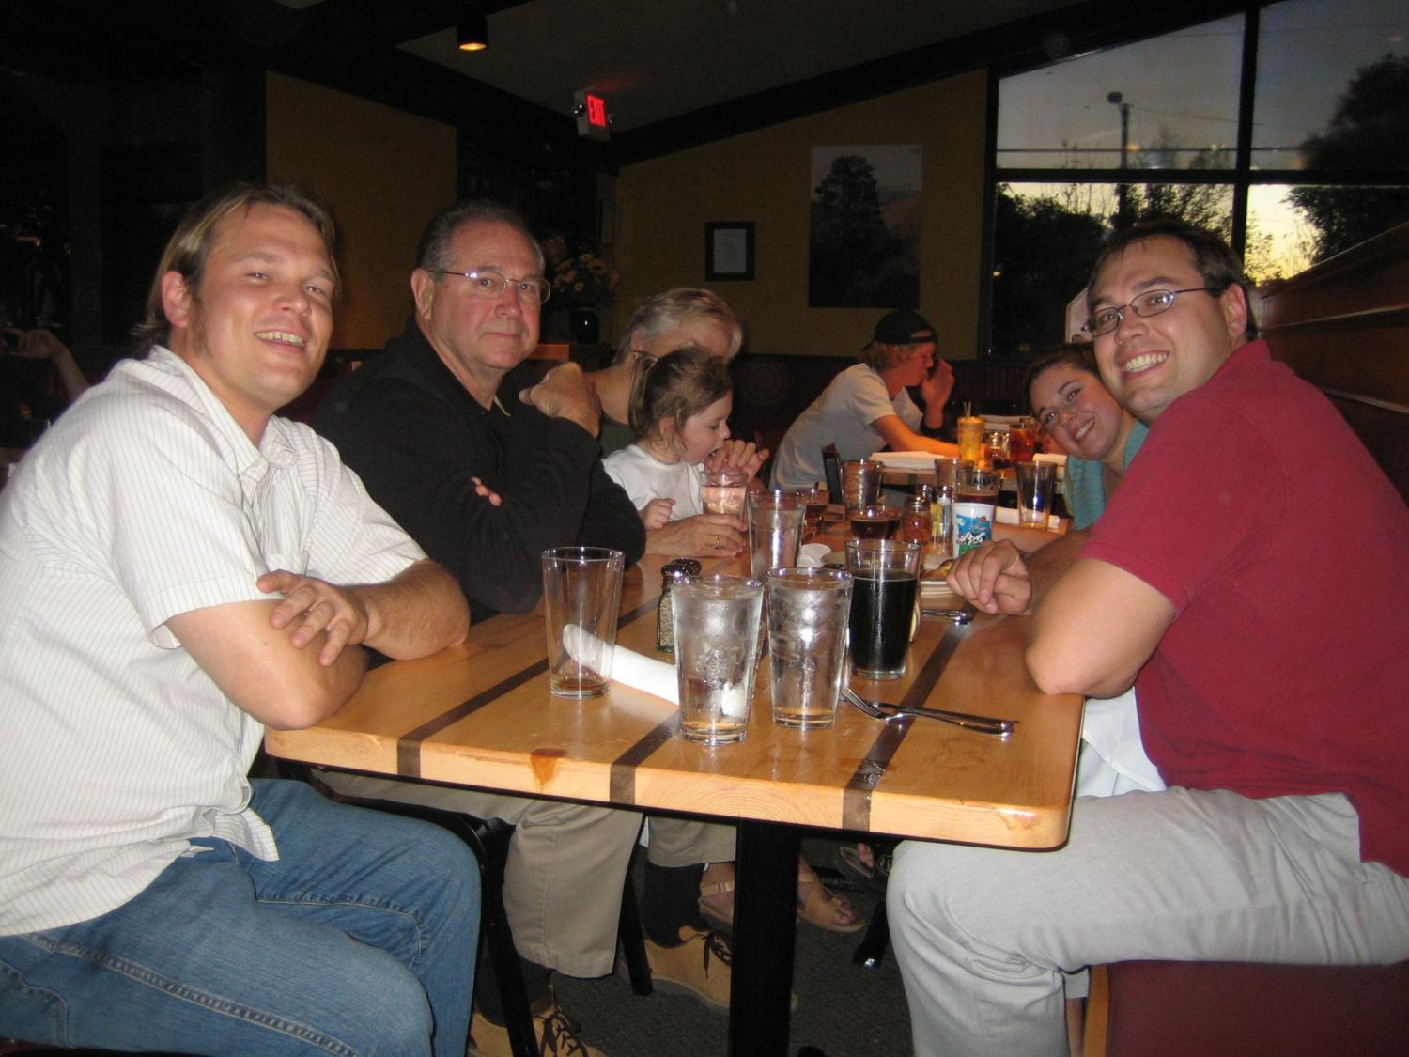

Slide 20
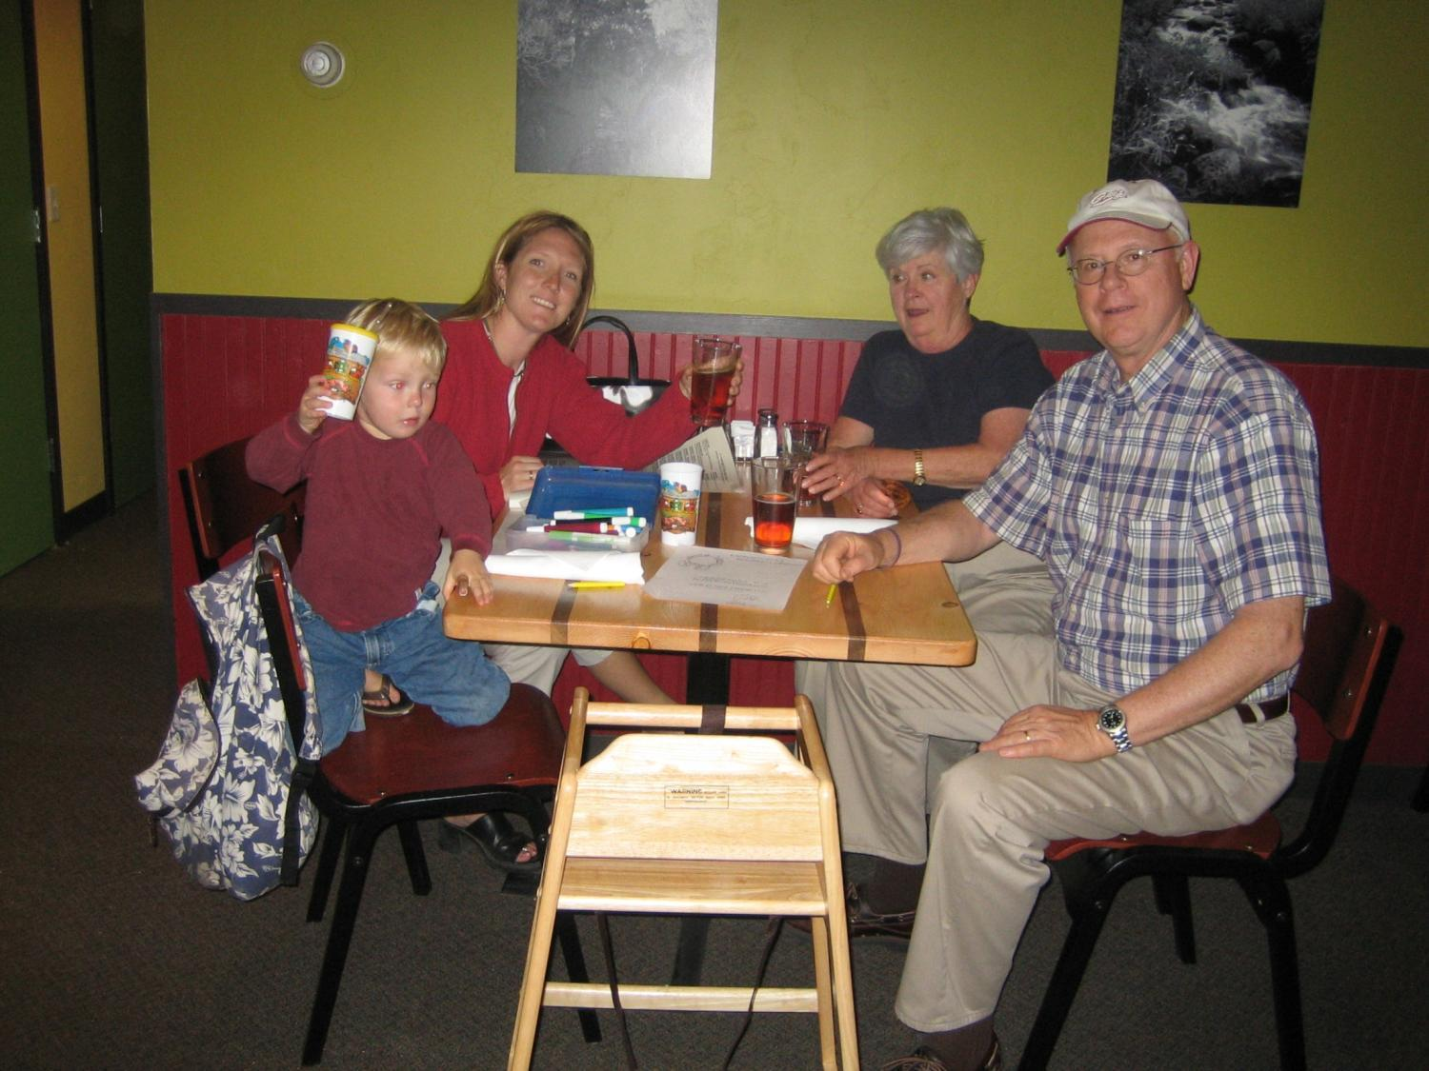

Slide 21
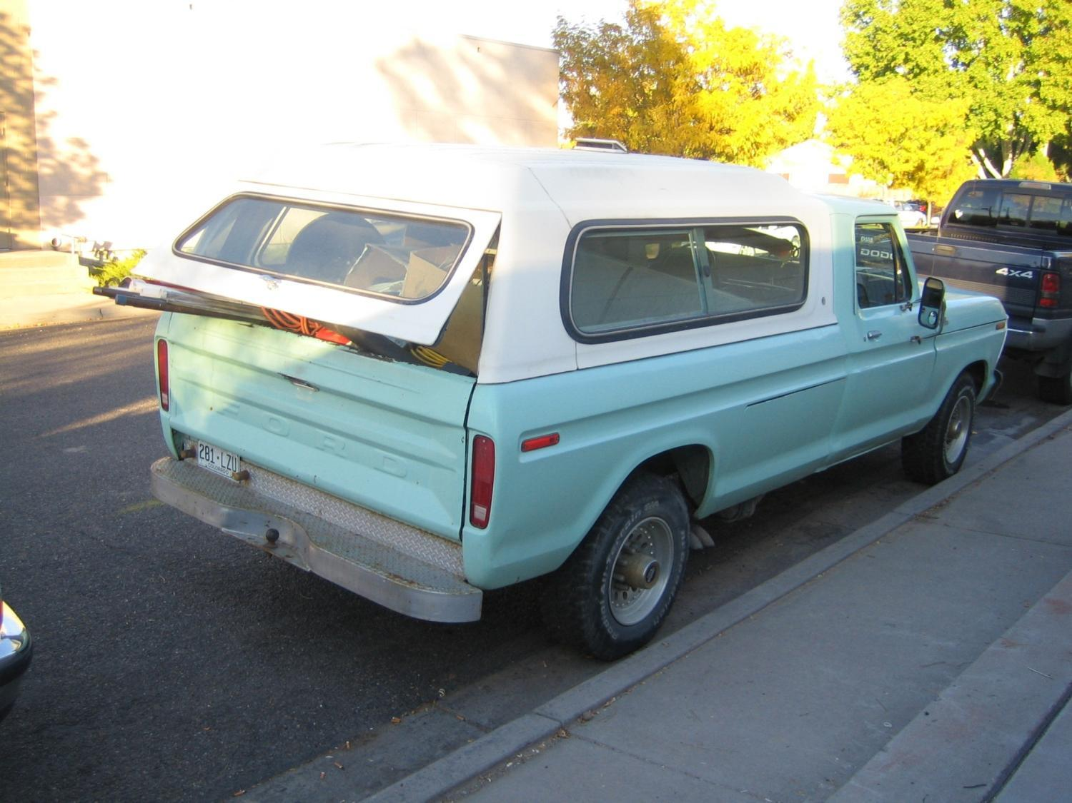

Slide 22
Quality is Your Friend
Quality costs less
Customers want the best – all the time
Buy in to constant improvement
Re-invest in the plan

Slide 23
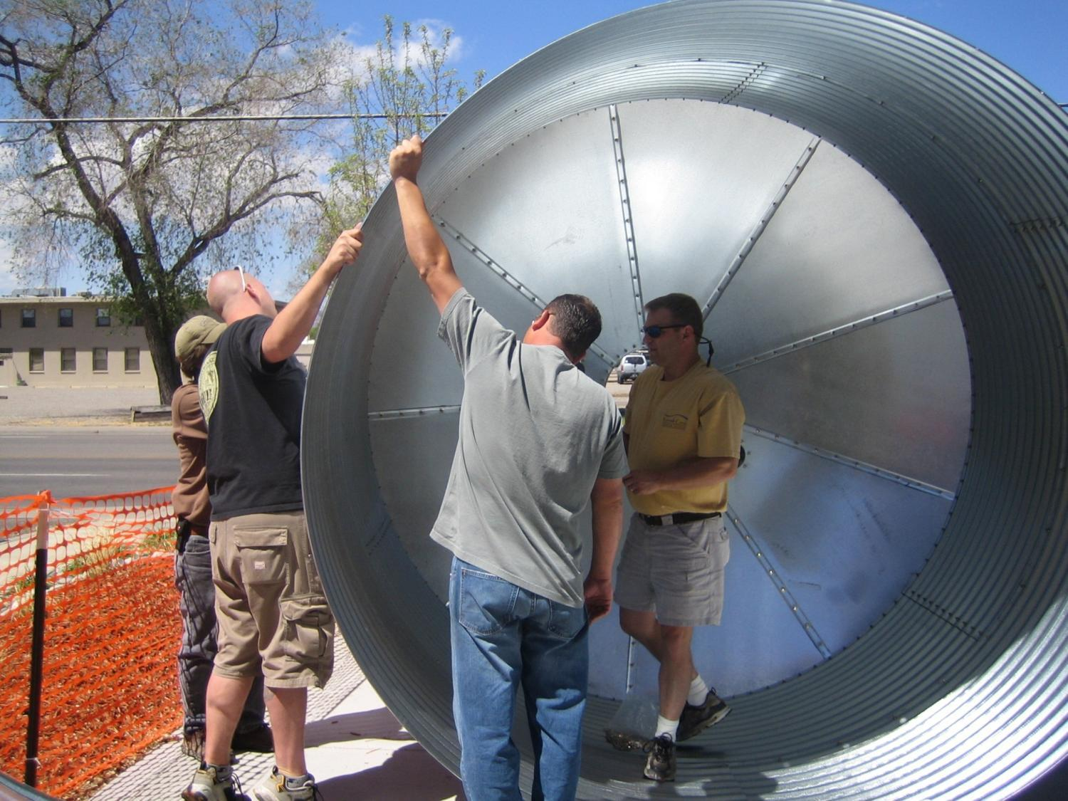

Slide 24
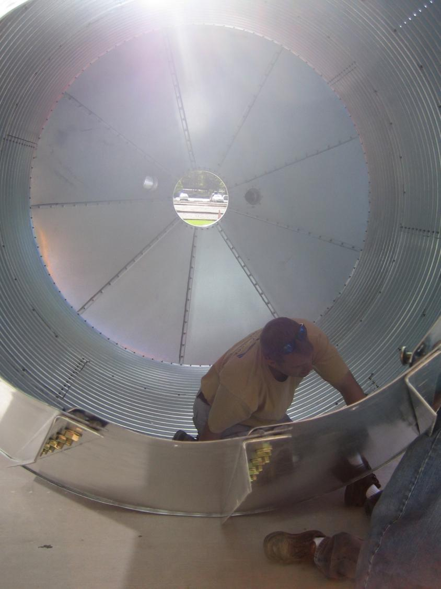

Slide 25
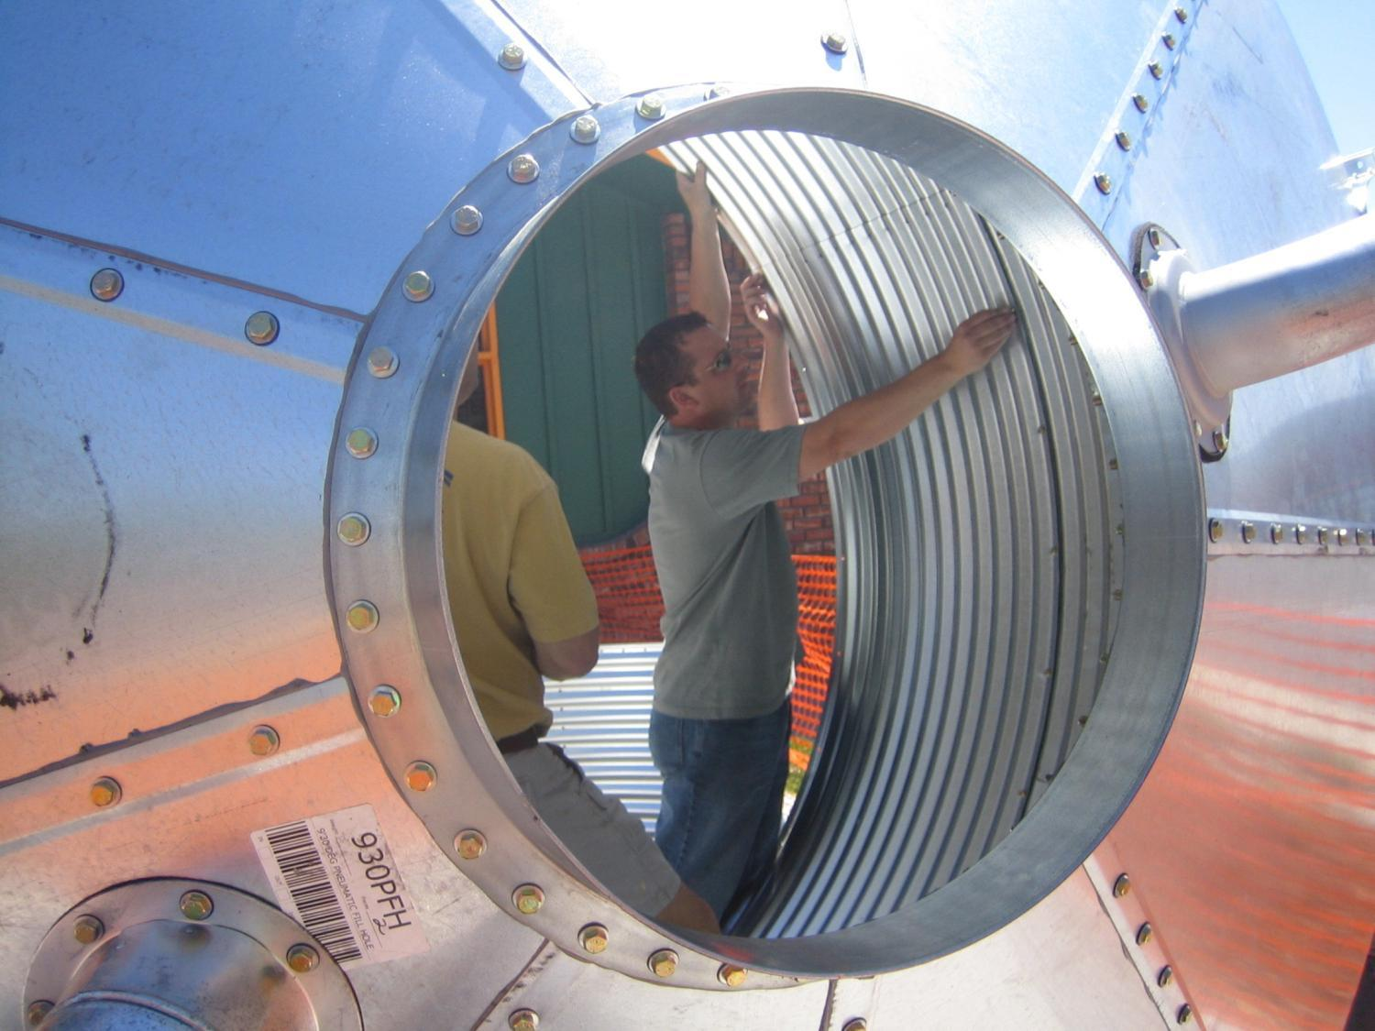

Slide 26
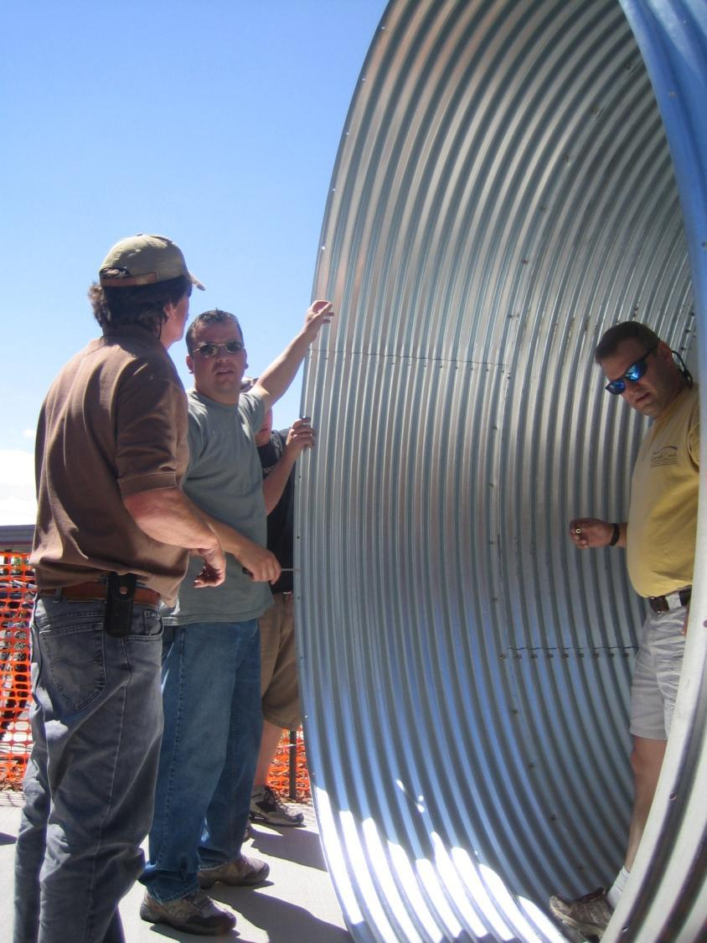

Slide 27
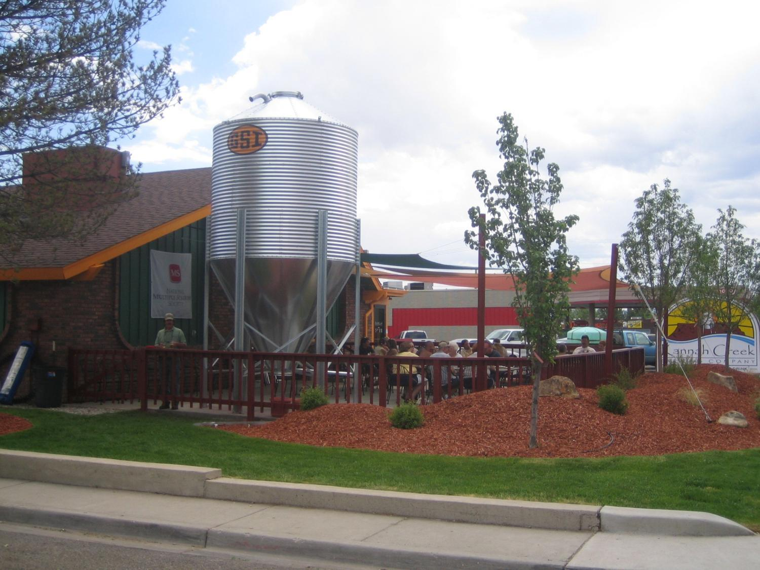

Slide 28
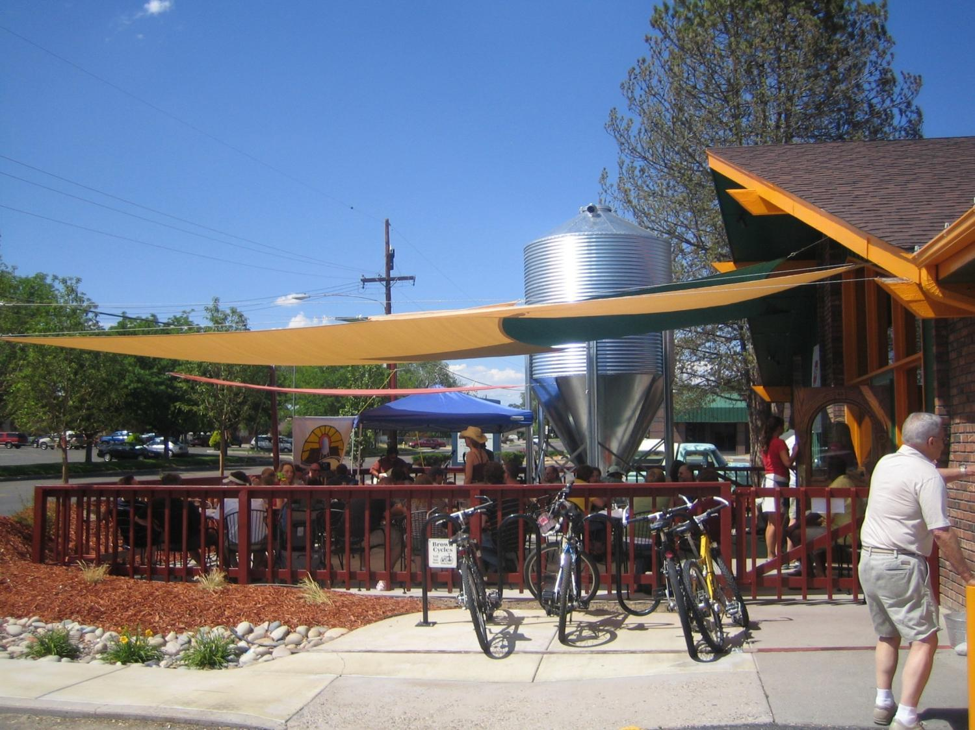

Slide 29
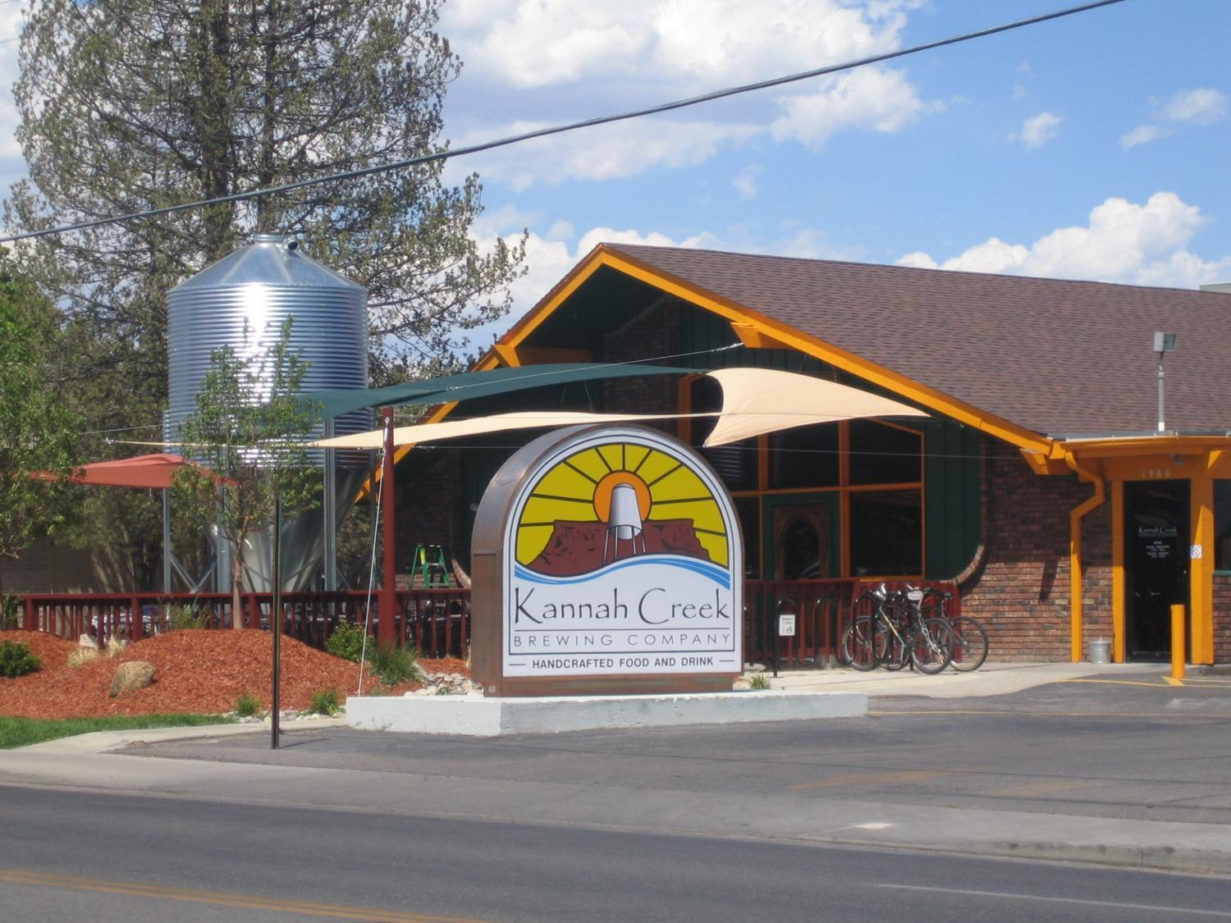

Slide 30
Fun is Possible
Go to Festivals
Talk about Beer – to everyone
Pace yourself
Host a beer geek meeting

Slide 31
